Slide 1
The Internet and Internet Services
Unit 8
Prepared by: Natabar Khatri New Summit College
Notes:
The internet has become an indispensable part of our lives, revolutionizing the way we connect, access information, and conduct business. But what exactly is the internet, and how does it work? Let's delve into its fascinating world.

Slide 2
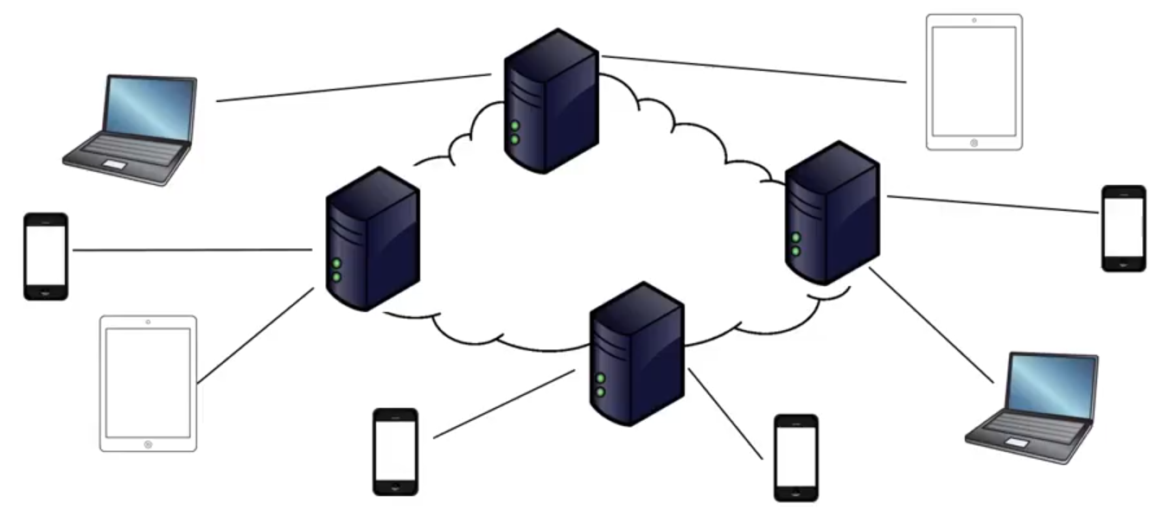
Introduction
The Internet: A Global Web of Networks
Internet is a network of machines (servers, clients, routers, switches, etc.) connected by media (fiber, wifi, etc.) that allows communication among devices.
We can think of the internet as a graph:
Nodes represent devices and information
Edges represent a connection (physical or virtual)

Slide 3
Introduction
How Does it Work?
The internet functions using a complex set of protocols, which are essentially rules that govern communication between devices. The two most crucial protocols are:
Internet Protocol (IP): This assigns a unique address (IP address) to every device on the network, like a digital house number.
Transmission Control Protocol (TCP): This breaks down data into smaller packets, transmits them across the network, and ensures they reach their destination in the correct order.

Slide 4
Intranet
Intranet and extranet are both private networks, but with key differences in who can access them:
Intranet:
Internal network within an organization to share information, operational systems, or computing services.
Think of it as a company's digital workplace.
Highly secure with limited users.
Extranet:
Extends the intranet to authorized external users like partners, vendors, or customers.
Extranet extend a private network onto the internet with special provisions for authentication, authorization and accounting.
Acts as a secure bridge between a company and its external contacts.
Requires user authentication for access.

Slide 5
History of Internet
1960s: The seeds are sown with ARPANET, a US Department of Defense project creating a communication network for researchers to share information during the Cold War.
1970s: Bob Kahn and Vint Cerf develop the TCP/IP protocol, the foundation for the modern internet's communication language.
1983: TCP/IP becomes the standard, allowing different networks to seamlessly connect, marking a significant step towards the internet as we know it.
1989: Tim Berners-Lee invents the World Wide Web (WWW), introducing hyperlinks and web pages, making information access user-friendly.
1990s: The internet explodes in popularity with the rise of web browsers, email, and search engines.
2000s: The internet becomes a social and commercial hub with the emergence of social media platforms, online shopping, and streaming services.
Present Day: The internet continues to evolve, shaping communication, education, and global interaction in profound ways.

Slide 6
Internetworking protocol
The Transmission Control Protocol/Internet Protocol (TCP/IP) suite is the foundation of internetworking. It's a layered model with each layer performing specific functions:
Network Access Layer: Establishes the physical connection between devices (Ethernet, Wi-Fi).
Internet Layer: Handles routing data packets across networks using IP addresses.
Transport Layer: Provides reliable (TCP) or connectionless (UDP) data transfer between applications.
Application Layer: Defines protocols for specific applications like HTTP (web browsing), FTP (file transfer), and SMTP (email).

Slide 7
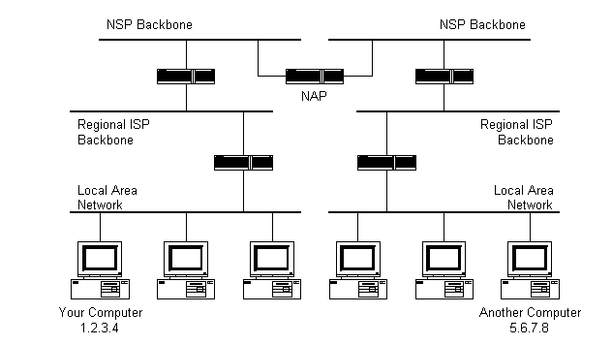

The internet architecture
The architecture of internet is hierarchial in Nature consisting of Clients, Local Internet Service Provider (ISP), Regional ISP, Backbone and Network Access Point (NAP).

Slide 8
The internet architecture
Client: This is your device, like your computer or phone, that connects to the internet.
Local ISP (Internet Service Provider): This is your local internet provider, the company you pay for internet access. They connect you to the bigger internet.
Regional ISP: These ISPs act as middlemen, buying bandwidth from national ISPs and reselling it to local ISPs.
National ISP (Tier 1): These are the big players with high-speed backbone networks spanning large regions or even globally. They have peering agreements to exchange traffic efficiently.
Backbone: Think of this as the internet's highway system. It's a network of high-bandwidth connections carrying most of the internet traffic between National ISPs.
Network Access Point (NAP): These are physical locations where multiple ISPs interconnect, allowing them to exchange traffic directly without going through a central hub. This helps keep data transfer efficient.

Slide 9
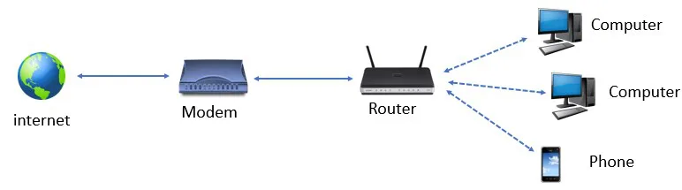
Managing the internet
Connecting to internet
To be able to connect your computer to the internet, you require
A TCP/IP enabled computer,
Software like web browser
An account with an ISP,
Connection line (telephone line, coaxial cable or fiber connection),
Hardware like modem or Network Interface Card (NIC) to connect computer to the network

Slide 10
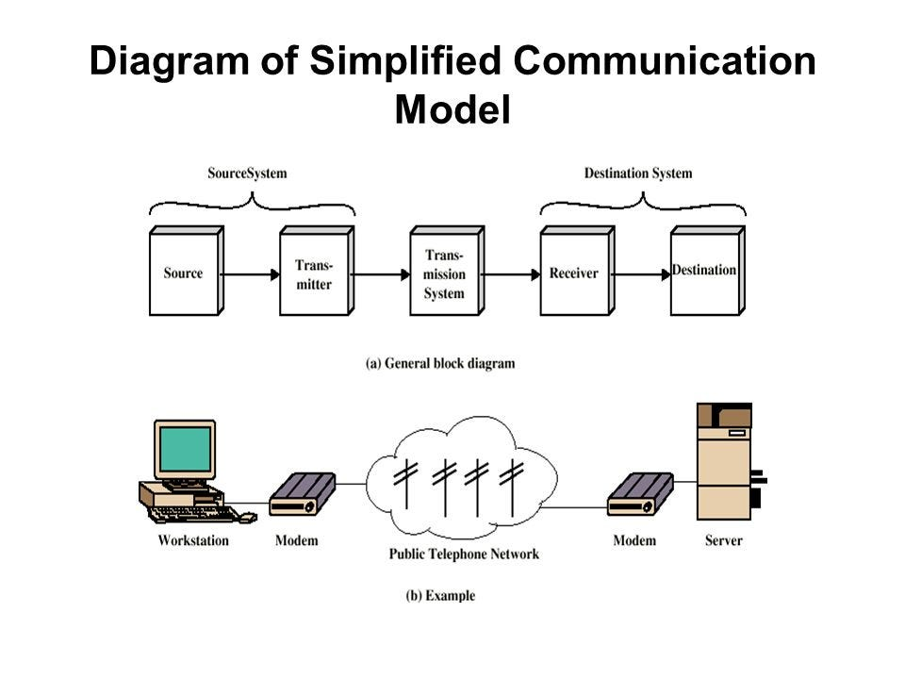
Internet connections
Different types of internet connections are provided by the ISPs. User can select the internet connection on the basis of their requirement i.e. bandwidth and cost.
Bandwidth is the amount of data that can be transferred through a communication medium in a fixed amount of time. The speed of internet access depends on bandwidth. Speed of internet increases with the increase in bandwidth.

Slide 11
Internet connections
Some of the internet connections offered by local ISPs are discussed below:
Dial-up Access: This is the oldest and slowest option. It uses your phone line to connect to the internet, making your phone line unusable while connected. Speeds are typically very slow, around 56 kbps (kilobits per second).
Leased Line: This is a dedicated, high-bandwidth connection ideal for businesses with critical online needs. It provides a constant, reliable connection with symmetrical upload and download speeds, meaning data travels just as fast in both directions. However, leased lines are also the most expensive option.
Integrated Services Digital Network (ISDN): ISDN uses your existing phone line but offers faster speeds than dial-up (up to 128 kbps). It can handle both voice and data simultaneously, allowing you to use your phone and internet at the same time. However, ISDN is becoming less common as newer technologies offer much higher speeds.

Slide 12
Internet connections
Digital Subscriber Line (DSL): DSL utilizes your existing phone lines but with much higher bandwidth than ISDN. It transmits data over unused frequencies on the phone line, allowing for internet access while keeping your phone line free. Speeds can range from hundreds of kbps to tens of Mbps (megabits per second).
Cable Modem: This service uses your cable TV cable line to deliver internet access. It offers faster and more consistent speeds than DSL, typically ranging from Mbps to hundreds of Mbps. However, cable internet can be impacted by network congestion during peak usage times in your area.

Slide 13
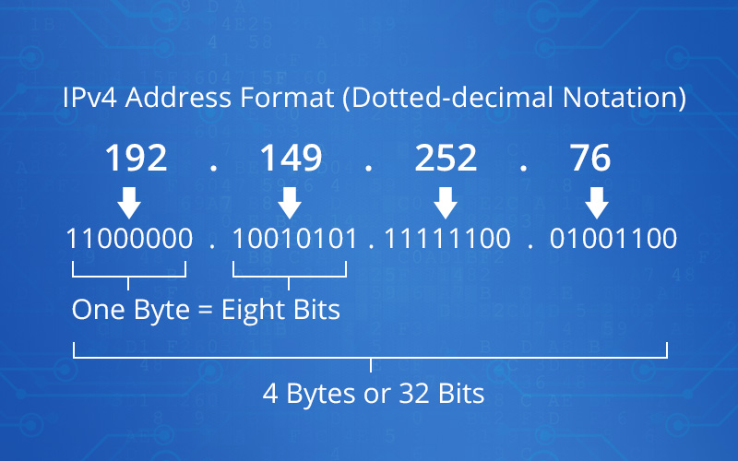
Internet address
An internet address acts like a unique identifier for devices on a network, allowing them to communicate and find each other.
An IP address is a numerical label assigned to a device connected to a network using the Internet Protocol (IP). It acts like a digital mailing address, allowing information to be routed to the correct device.

Slide 14
Internet address
The IP addresses have the following characteristics in common.
IP addresses are unique. No two machines can have the same IP number.
IP addresses are also global and standardized.
All machines connected to the internet agree to use the same scheme for establishing an address.
IPv4 and its Five Classes:
IPv4 was the first widely used IP address format. Due to its limited address space, it's being phased out in favor of IPv6. Here's a breakdown of the five classes in IPv4 (no longer strictly followed due to address depletion):
Class A: Used for large networks (0.0.0.0 - 127.255.255.255)
Class B: Used for medium-sized networks (128.0.0.0 - 191.255.255.255)
Class C: Used for small networks (192.0.0.0 - 223.255.255.255)
Class D: Reserved for multicast addressing (224.0.0.0 - 239.255.255.255)
Class E: Reserved for future use (240.0.0.0 - 255.255.255.255)

Slide 15
Internet address
IPv6: IPv6 was created to address the limited address space of IPv4. It offers a significantly larger pool of addresses using 128 bits. This future-proofs the internet for the ever-growing number of connected devices.
Address Types: Unicast, Anycast, and Multicast
Unicast Address: The most common type, a unicast address identifies a single device on the network. When you send an email or browse a website, a unicast address is used to direct the information to the specific device.
Anycast Address: An anycast address identifies a group of devices where the closest device within the group receives the information. This is often used for content delivery networks (CDNs) to deliver content from the geographically closest server.
Multicast Address: A multicast address identifies a group of devices on the network. When information is sent to a multicast address, all devices subscribed to that group receive it. This is useful for applications like online gaming or video conferencing.

Slide 16
Domain Name
A domain name is like your website's address on the internet. It's the user-friendly name that people type into their web browser to find your site, replacing the complex numerical IP address that computers use. Here's a deeper dive into the world of domain names:
Anatomy of a Domain Name:
Labels: A domain name consists of one or more labels separated by dots. These labels work together to form the complete address. For example, in "www.google.com", "www" is a subdomain, "google" is the second-level domain (SLD), and ".com" is the top-level domain (TLD).
Top-Level Domains (TLDs): These are the suffixes at the end of a domain name, like ".com", ".org", or ".net". They provide a general category about the website's content or purpose. Some common TLDs include:
.com: Most popular for commercial entities
.org: Used for organizations and non-profits
.net: Originally for network infrastructure, now for general use
.edu: Educational institutions
There are also country code TLDs (ccTLDs) like ".in" for India or ".uk" for the United Kingdom. Additionally, new TLDs like ".shop" or ".tech" have emerged for specific purposes.

Slide 17
Domain Name
Second-Level Domain (SLD): This is the most memorable part of the domain name, typically chosen by the website owner. It should be clear, relevant to the website's content, and ideally brand-specific.
Subdomains: These are optional prefixes added before the SLD to further categorize parts of a website. For instance, "mail.google.com" is a subdomain for Google's email service.
How Domain Names Work:
Domain Name Registration: You purchase a domain name from a domain registrar, similar to renting a plot of land online. The registrar stores your registration information and makes the domain name active on the internet.
Domain Name System (DNS): Think of DNS as the internet's phonebook. When you type a domain name in your browser, the DNS translates it into the corresponding IP address, a unique numerical code assigned to each computer on the network. Your browser then uses this IP address to connect to the website's server and display the content.

Slide 18
Internet services
The internet offers a vast array of services that have revolutionized communication, information access, and entertainment. Some key internet services we use includes:
1. World Wide Web (WWW):
2. Web Browser:
3. Search Engines:
4. Electronic Mail (Email):
5. Internet Relay Chat (IRC):

Slide 19
Internet services
World Wide Web (WWW):
WWW is a specific service that provides a user-friendly way to access information on the internet.
It works through a system of interconnected hypertext documents called web pages. These web pages can contain text, images, videos, and links to other web pages.
Web browsers like Google Chrome, Mozilla Firefox, or Safari interpret the code behind these web pages and display them visually for you.

Slide 20
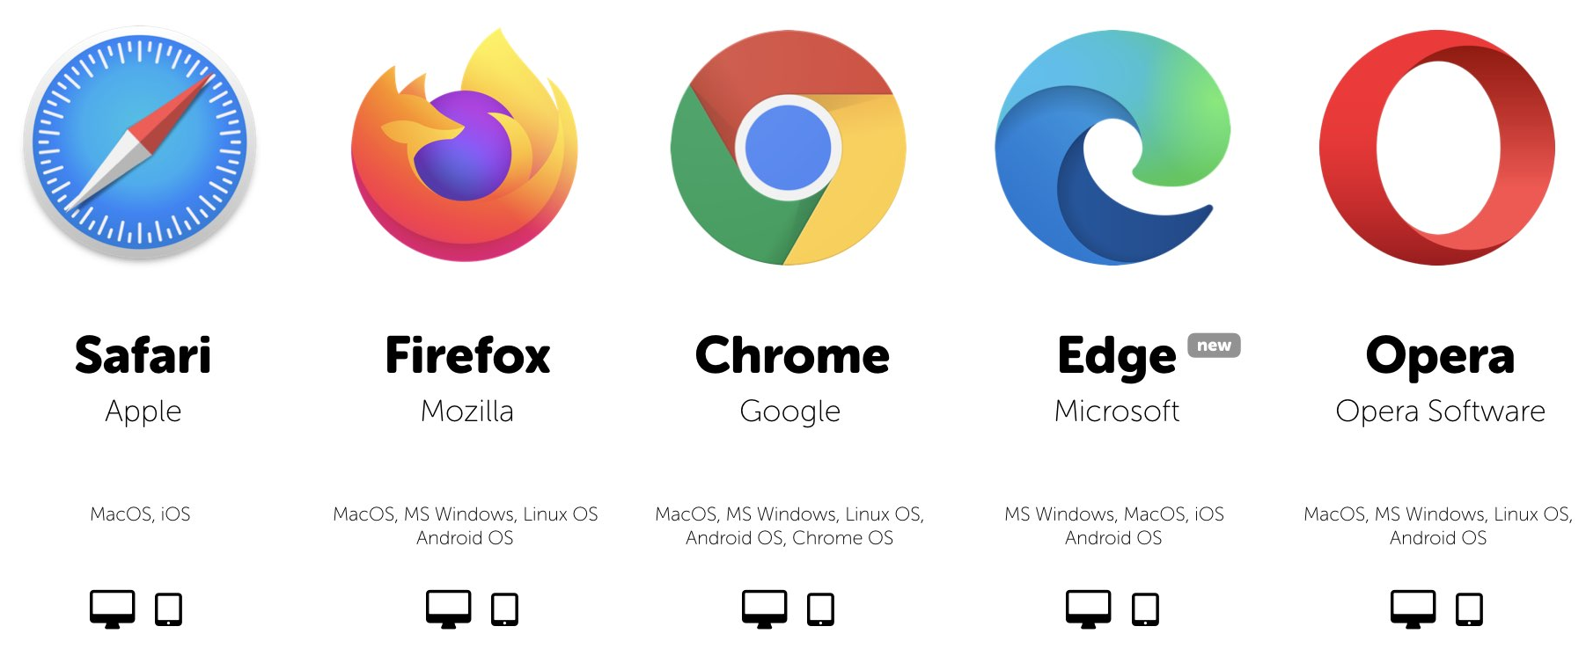
Internet services
Web Browser:
These are software applications that allow you to access and navigate the World Wide Web.
They translate the underlying code of web pages (HTML, CSS, JavaScript) into a visually appealing and interactive experience.
Browsers also manage features like bookmarks, history, and cookies to personalize your web browsing experience.

Slide 21
Internet services
Search Engines:
A search engine is a software system that provides hyperlinks to web pages and other relevant information on the Web in response to a user's query.
They index billions of web pages based on keywords and content, allowing users to search for specific information using keywords or phrases.
Major search engines include Google, Bing, DuckDuckGo, and Baidu.
Search engines use complex algorithms to rank search results based on relevance, popularity, and other factors.

Slide 22
Internet services
Electronic Mail (Email)
A widely used service for exchanging electronic messages (emails) between individuals or groups.
Emails consist of a sender, recipient(s), subject line, and message body. You can also attach files to emails for sharing documents, images, etc.
Emails rely on specific protocols to function smoothly:
SMTP (Simple Mail Transfer Protocol): Responsible for sending emails from your email client (like Outlook or Gmail) to a mail server.
POP3 (Post Office Protocol version 3): Used to retrieve emails from the mail server to your device.
IMAP (Internet Message Access Protocol): A more advanced protocol allowing you to access and manage emails on the server itself, enabling access from multiple devices.

Slide 23
Internet services
Internet Relay Chat (IRC):
One of the earliest forms of real-time online communication.
IRC uses a client-server model, where users connect to an IRC server using a dedicated IRC client software.
Users can join chat rooms dedicated to specific topics or interests and interact with others through text messages.
While less popular than modern instant messaging platforms, IRC still has a niche following for specific communities.

Slide 24
Uses of Internet
Communication: Email, social media, video chat, and instant messaging allow us to connect with people around the world easily and instantly.
Information: Research has never been easier. Search engines provide access to a vast amount of information on any topic imaginable.
Education: Online courses, educational websites, and video tutorials offer a flexible and accessible way to learn new skills or gain knowledge.
Shopping: E-commerce allows us to shop from a variety of stores without leaving our homes.
Banking: Online banking makes it convenient to manage finances, check account balances, and transfer funds.
Entertainment: Streaming services, online gaming, and social media provide a vast array of entertainment options.
Social Connection: Social media platforms connect us with friends and family, and help us build new relationships with people who share our interests.
Business: The internet is essential for businesses of all sizes. It enables communication with customers, marketing, and online sales.

Slide 25
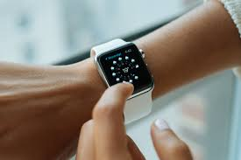
Wearable computing
Wearable computing is the concept of incorporating electronic devices into clothing and accessories that you can wear on your body. These devices are miniature computers with various functionalities, often designed to be seamlessly integrated into your daily life.
They can range from simple devices like fitness trackers to more complex smartwatches with advanced features.

Slide 26
Wearable computing
Functionality: The functionalities of wearables vary greatly depending on the device. Some common features include:
Fitness tracking (steps, heart rate, calories burned)
Health monitoring (blood pressure, blood oxygen)
Mobile notifications (calls, texts, emails)
Payments
Music control
Augmented reality overlays
Benefits: Wearable computing offers several advantages:
Convenience: Easy access to information and functionality without needing a separate device like a phone.
Health and Fitness Monitoring: Can help you track your health and fitness goals.
Safety: Some wearables can be used for emergency calls or notifications.
Augmented Reality: Overlays digital information onto the real world, enhancing experiences.

Slide 27
Wearable computing
Examples: Here are some popular examples of wearable computing devices:
Smartwatches (Apple Watch, Samsung Galaxy Watch)
Fitness Trackers (Fitbit, Xiaomi Mi Band)
Smart Glasses (Google Glass)
Smart Clothing (biometric monitoring shirts, heated jackets)

Slide 28
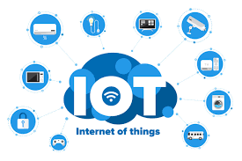
Introduction to Internet of things (IOT)
The Internet of Things (IoT) refers to the vast network of physical devices embedded with sensors, software, and other technologies that connect and exchange data with each other over the internet. These devices can range from simple everyday objects like thermostats and light bulbs to complex industrial machinery and medical equipment.

Slide 29
Introduction to Internet of things (IOT)
Key Features:
Connectivity: Devices connect and communicate with each other and central systems.
Data Collection: Sensors gather data about the environment and device status.
Automation: Systems can automate tasks based on collected data.
Benefits:
Improved Efficiency: Automates tasks, optimizes processes, and reduces waste.
Enhanced Decision-Making: Provides real-time data for better decision-making.
New Services and Products: Enables innovative applications and services.
Applications:
Smart Homes: Automated lighting, temperature control, and security systems.
Smart Cities: Traffic management, waste collection, and environmental monitoring.
Wearable Technology: Fitness trackers, smartwatches, and health monitoring devices.
Industrial IoT: Predictive maintenance, remote monitoring, and supply chain optimization.

Slide 30
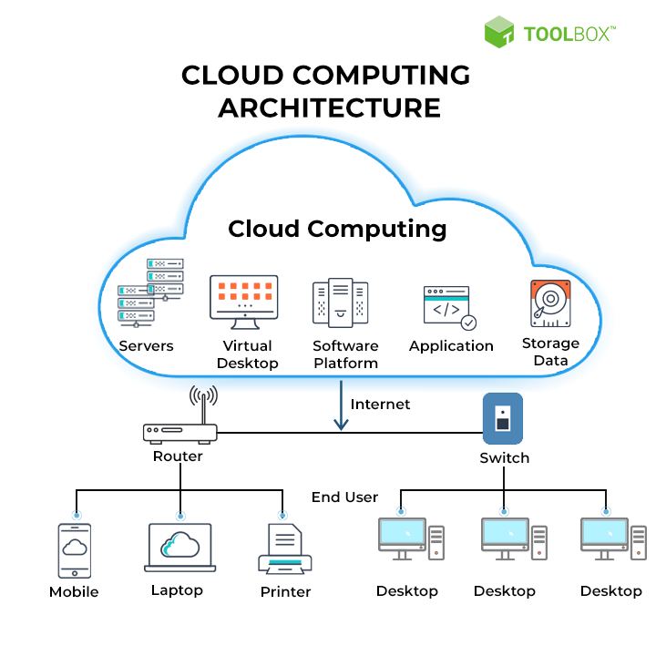
cloud computing
Cloud computing is a model for delivering on-demand access to computing resources like servers, storage, databases, networking, software, and analytics over the internet. Users can access these resources without the need to manage physical infrastructure themselves.

Slide 31
cloud computing
Service Models:
Infrastructure as a Service (IaaS): Rent virtualized computing resources like servers and storage.
Platform as a Service (PaaS): Access a platform for developing, deploying, and managing applications.
Software as a Service (SaaS): Use software applications delivered over the internet, typically on a subscription basis.
Benefits:
Scalability: Easily adjust resources up or down based on needs.
Cost-effectiveness: Pay only for the resources you use.
Flexibility: Access resources from anywhere with an internet connection.
Security: Cloud providers invest heavily in security measures.
Applications:
Data Storage and Backup
Web Applications and Services
Big Data Analytics
Disaster Recovery

Slide 32
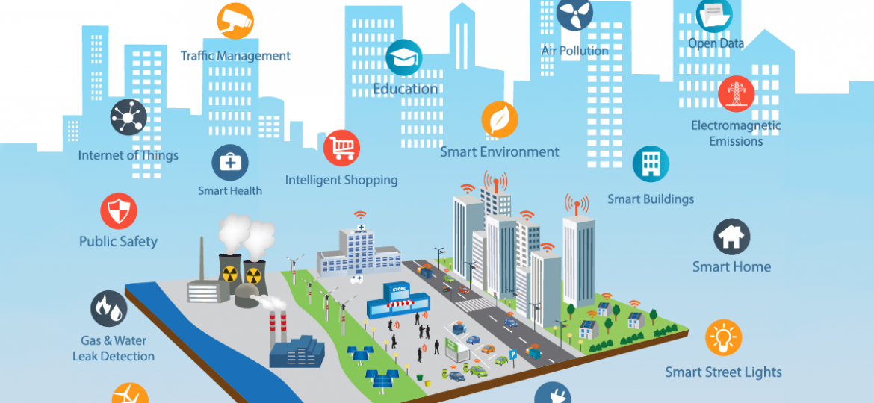
Smart city

Slide 33
Smart city
A smart city utilizes technology to improve the efficiency, sustainability, and overall quality of life for its citizens. It integrates various technologies like IoT, cloud computing, big data, and artificial intelligence (AI) to create a more interconnected and data-driven urban environment.
Key Components:
Smart Infrastructure: Intelligent transportation systems, energy grids, and waste management.
Connected Citizens: Access to information and services through mobile apps and citizen portals.
Data-Driven Governance: Utilizing data to optimize city services and make informed decisions.
Benefits:
Improved Traffic Management: Reduce congestion and optimize traffic flow.
Enhanced Public Safety: Real-time monitoring and emergency response systems.
Environmental Sustainability: Promote energy efficiency and resource conservation.
Citizen Engagement: Increase citizen participation and improve communication.

Slide 34
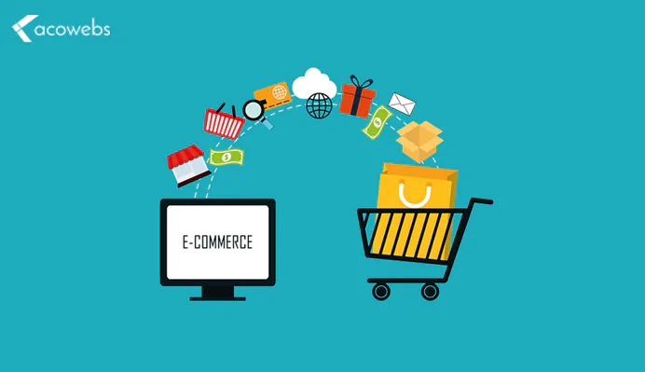
Introduction to e-commerce
E-commerce refers to the buying and selling of goods and services over the internet. It encompasses online stores, marketplaces, and other platforms that facilitate online transactions.
Types of E-commerce:
Business-to-Consumer (B2C): Businesses selling directly to consumers (e.g., Amazon, eBay).
Business-to-Business (B2B): Businesses selling to other businesses (e.g., electronic marketplaces for industrial supplies).
Consumer-to-Consumer (C2C): Platforms for individuals to sell directly to each other (e.g., online marketplaces for used goods).

Slide 35
Introduction to e-commerce
Benefits:
Convenience: Shop anytime, anywhere with an internet connection.
Wider Selection: Access to a vast range of products and services.
Competitive Prices: Compare prices from multiple sellers easily.
Personalized Shopping: Recommendations and targeted marketing based on user preferences.

Slide 36
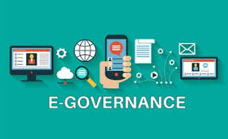
E-governance
E-governance refers to the use of technology to deliver government services, improve communication with citizens, and enhance public participation. It aims to make government operations more efficient, transparent, and accountable.

Slide 37
E-governance
Applications:
Online Services: Accessing government forms, licenses, and permits electronically.
E-voting: Secure online voting systems.
Citizen Engagement: Platforms for citizens to interact with government and provide feedback.
Transparency: Public access to government data and information.
Types of E-governance:
E-governance utilizes technology to improve communication and service delivery between various entities. four main types of E-governance interactions are as follows
Government to Citizen (G2C):
Government to Business (G2B):
Government to Government (G2G):
Government to Employee (G2E):

Slide 38
E-governance
1. Government to Citizen (G2C):
This is the most common type of e-governance, focusing on delivering government services to citizens electronically. It aims to make interacting with the government more convenient, efficient, and transparent.
Examples:
Online portals for applying for licenses, permits, or social benefits.
E-filing of taxes.
Online bill payments for utilities or traffic violations.
Public information dissemination websites.
2. Government to Business (G2B):
G2B focuses on streamlining interactions between the government and businesses. It facilitates electronic transactions and improves the efficiency of government processes for businesses.
Examples:
Online portals for submitting business registrations, tenders, and tax returns.
Electronic procurement systems for government contracts.
Business licensing and permit applications through online platforms.
Access to government data and statistics for business analysis.

Slide 39
E-governance
3. Government to Government (G2G):
This type of e-governance involves electronic interaction and data exchange between different government agencies and departments. It promotes collaboration, improves efficiency, and reduces administrative burdens.
Examples:
Sharing information and resources between government agencies.
Online collaboration platforms for joint projects.
Standardizing data formats and communication protocols across government entities.
Inter-governmental e-procurement systems.
4. Government to Employee (G2E):
G2E refers to the use of technology to manage internal government operations and communication with employees. It can improve efficiency, transparency, and employee engagement within government agencies.
Examples:
Online training and development programs for government employees.
Internal communication platforms for news announcements and policy updates.
Electronic document management systems for streamlining workflows.
Payroll and benefits administration through online portals.

Slide 40
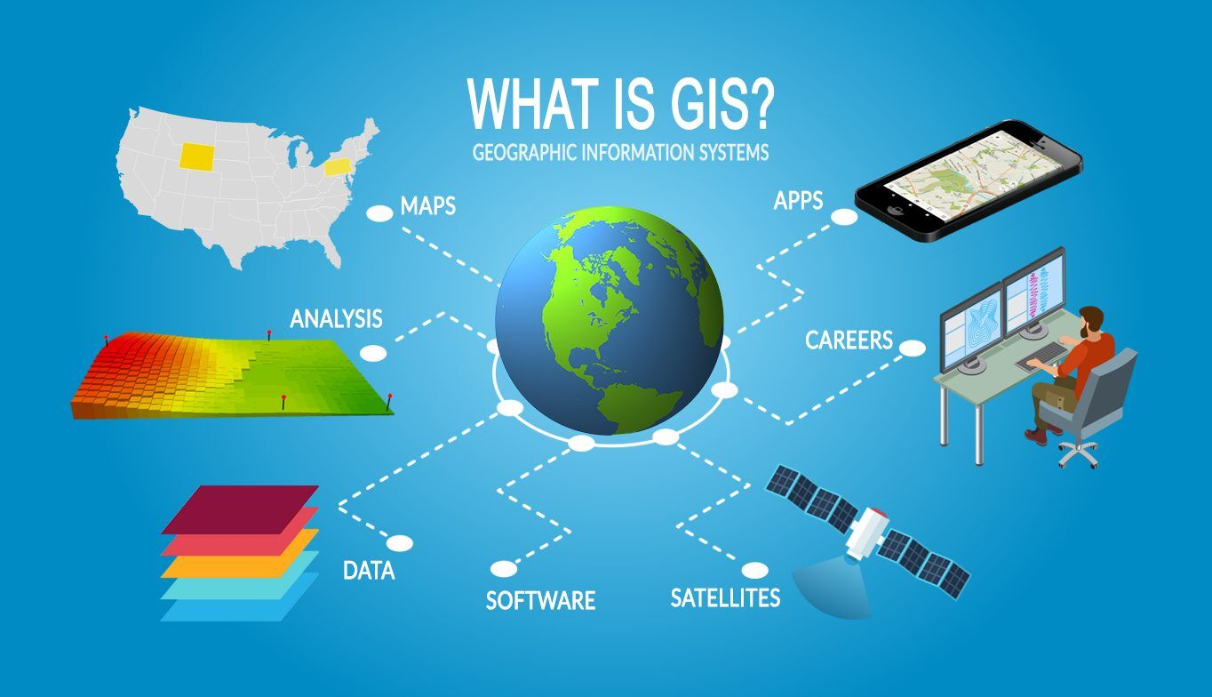
gis
A Geographic Information System (GIS) is a powerful computer system that captures, stores, analyzes, and displays geographic data. It's essentially a digital toolbox for working with information that has a location on Earth.

Slide 41
gis
Applications of GIS:
GIS has a wide range of applications across various sectors. Here are some examples:
Urban Planning: Analyze demographics, land use, and infrastructure for informed urban development plans.
Environmental Management: Monitor deforestation, track pollution sources, and map wildlife habitats.
Disaster Management: Identify areas at risk, assess damage after natural disasters, and plan evacuation routes.
Public Health: Track disease outbreaks, identify high-risk populations, and allocate resources efficiently.
Precision Agriculture: Optimize crop yields, manage soil health, and monitor water usage based on spatial data.
Logistics and Supply Chain Management: Optimize delivery routes, track assets in real-time, and identify potential disruptions.

Slide 42
gis
Physical Components of GIS:
A GIS system typically consists of five main components:
Hardware: Computers, servers, and other electronic devices needed to run the GIS software.
Software: Specialized GIS software applications for data input, manipulation, analysis, and visualization.
Data: Geographic data like maps, satellite imagery, demographic information, and environmental data.
Users: People who interact with the GIS, including data analysts, planners, researchers, and decision-makers.
Procedures: Established workflows and methodologies for data collection, analysis, and presentation.

Slide 43
gis
GIS and Related Technologies:
GIS works effectively alongside other technologies that provide valuable spatial data:
Desktop Mapping: GIS software often integrates with desktop mapping tools for creating custom maps and visualizations.
Computer-Aided Design (CAD): GIS can be used to incorporate CAD drawings of infrastructure and buildings into spatial analyses.
Remote Sensing: Satellite imagery and aerial photographs provide valuable data for land cover analysis, change detection, and environmental monitoring within GIS.
Global Positioning System (GPS): GPS data from handheld devices or embedded sensors can be used to collect real-time location information and integrate it into the GIS.
Database Management Systems (DBMS): GIS often interacts with DBMS to store, manage, and query large datasets efficiently.

Slide 44
gis
Advantages of GIS:
Implementing GIS offers several benefits for organizations and individuals:
Cost Saving from Greater Efficiency: Streamline workflows, optimize resource allocation, and reduce manual data processing costs.
Improved Communications: Create clear and compelling maps and visualizations for better communication and collaboration.
Better Decision Making: Gain data-driven insights to support informed decision-making across various fields.
Better Record Keeping: Maintain a centralized and organized repository of spatial data for future reference.
Managing Geographically Dispersed Assets: Track and monitor assets, resources, and infrastructure located across vast areas.

